Slide 1

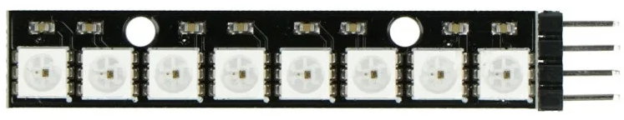
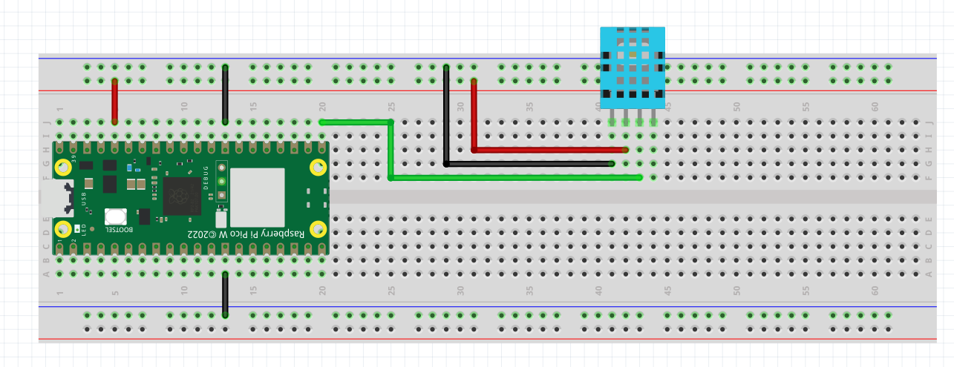
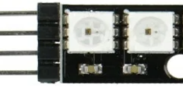
COLOUR YOUR LIFE WITH NEOPIXELS☺
Introducing the WS2812 LED Strip
Each of the LED in the strip
is addressable using the indices
as shown in this diagram
The first LED is 0
Second is 1
…..
Last on is 7
GND
VCC
DI
GND
Wiring Diagram – Please wire up as follows
This pin not required
DI PIN TO GPIO 16

Slide 2
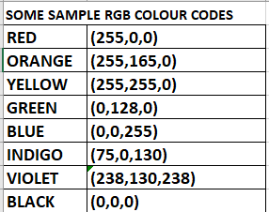
The WS2812 uses the neopixel library.
This library is included in the firmware, so there’s no need
to download any packages for its use.
Wire it up and let’s test it in Thonny’s SHELL
neopixel is the library we need to control the WS2812 strip
np is the variable name we assign to this strip.
It can be any variable name
>>> from machine import Pin
>>> import neopixel
>>> np = neopixel.NeoPixel(Pin(16), 8)
16 is the GPIO Pin number DI pin of the WS2812 is connected to
8 is the number of LEDs on this strip. In our case it is 8.
There are strips with more or less LEDs than what we have
To illuminate the LED on the strip we
to provide 2 pieces of data to the strip
1 - the index number (0 to 7) of the LED we want to illuminate
2 – the colour we want to illuminate it with- it is represented
as a tuple. See the attached samples
Source : https://www.html.am/html-codes/color/color-scheme.cfm
>>> np[0] = (0, 128, 0)
>>> np.write()
These codes will
Turn the first LED
GREEN

Slide 3
This is Ex 5
You know how to turn the first LED on.
No turn the other LEDs ON USING THE SAMPLE COLOUR PROVIDED
Go to the colour scheme website provided and try other colours.
1st Challenge. How to turn the LED off after you illuminate it?
2nd Challenge. Refer to attached video. See if you can replicate it.
Hint: Requires : for loop and sleep

Slide 4
Ex5a – illuminating each LED with a different colour
You can use the program from Ex5 and make modifications to it.
You can put the colours for each of the LED in a python List like this
colour=[(255,0,0),(255,165,0),(255,255,0),(0,128,0),(0,0,255),(75,0,130),(238,130,238),(255,125,125)]
This way you can call the respective colour by just using the index of the list – colour[].
For example colour[0] will be (255,0,0)
colour[7] will be (255,125,125)

